Slide 1


TASK ON
Code Refactoring and Bug Fixing

Slide 2
About me
I did Complete Bachelor of Technology .
The motivations for learning data science can vary from person to person, but it often involves a combination of intellectual curiosity, career aspirations, and the desire to make a positive impact .
I am currently working as a data science intern .
GitHub Link :
LinkedIn :
https://github.com/dadipavankumar118
https://www.linkedin.com/in/pavankumardadi/

Slide 3
Scenario:
A team of enthusiastic data scientists embarked on a mission to develop a Note Taking Application using Python, Flask, and HTML. However, their lack of experience in backend development has led to challenges in making the application fully functional. Recognizing your proficiency in backend development, you have been tasked with fixing the broken code and ensuring the application works seamlessly.
Task:
Refactor the existing codebase and ensure the proper functioning of the Note Taking Application. Document all identified bugs during the debugging process. Remember, the task is not about recreating the app from scratch. Your goal is to fix the already existing codebase and make the application work as intended.

Slide 4
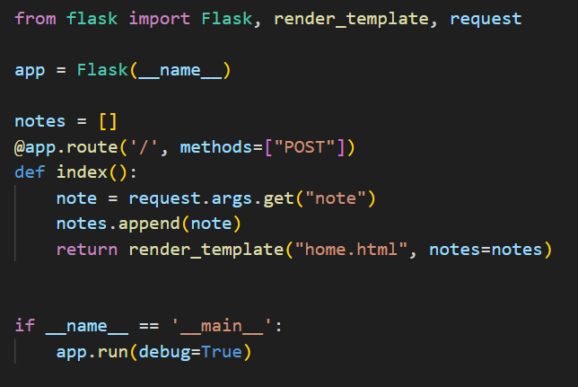
Bug Finding in Application Server:
Method is set to be “POST” only. “POST” method used to write data using request. But we also require to Read data from server using request.
Here Data is not transfer using URL. Data is transfer using HTML from element.
1
2

Slide 5
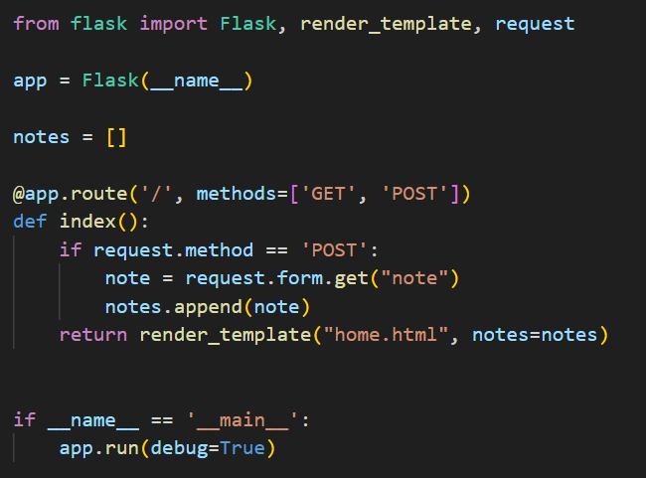
Bug Fixing in Application Server:
To add “GET” also in method parameter of route in python Flask application server.
To read data from HTML form element. GET note using request.form.get(“note”).
If we receive any empty data means it also add with existing notes. In order to avoid empty data we have to check for notes if it is not empty then add to our database.

Slide 6
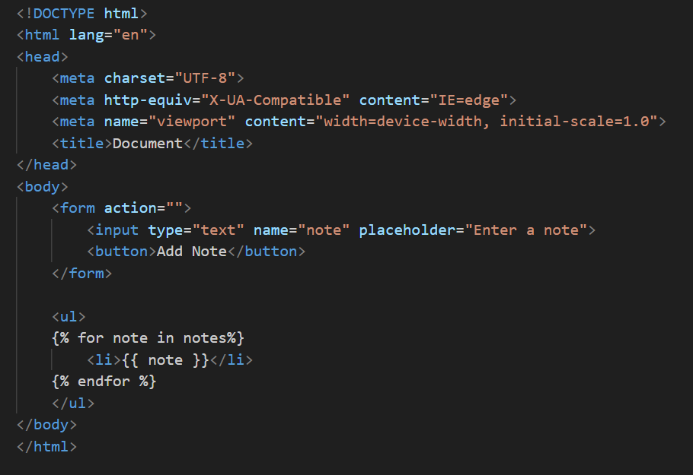
Bug Finding in HTML:
Element method is missing in the from tag.
Type parameter is missing in the button tag.
1
2

Slide 7
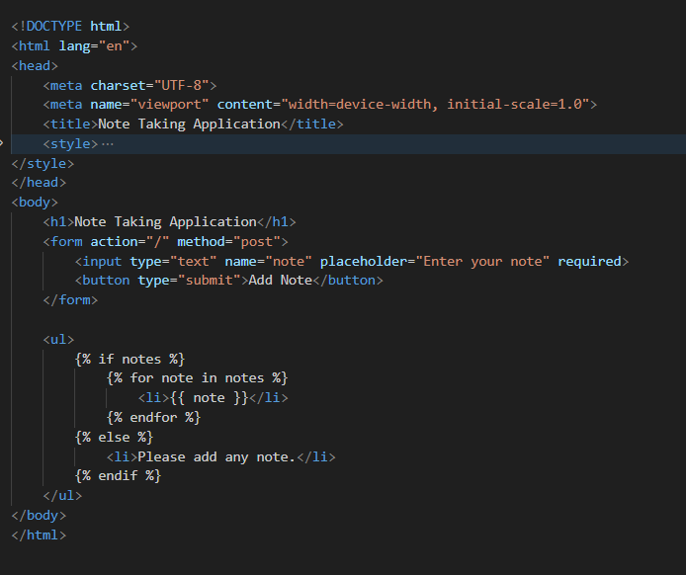
Bug Fixing in HTML:
Fill method = “POST” in the form tag.
Fill type = “submit” in the button tag.
If our notes database is empty then its show Please add any note if any notes present in the database it start showing notes.

Slide 8
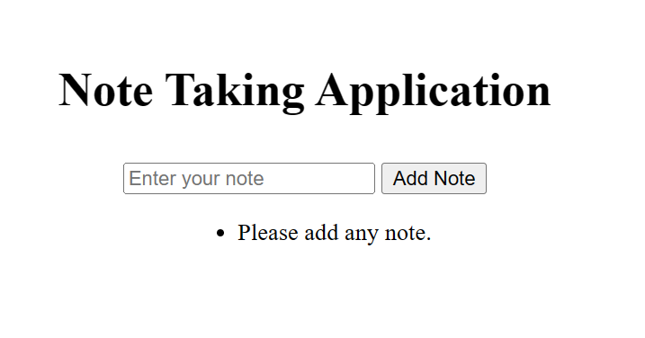
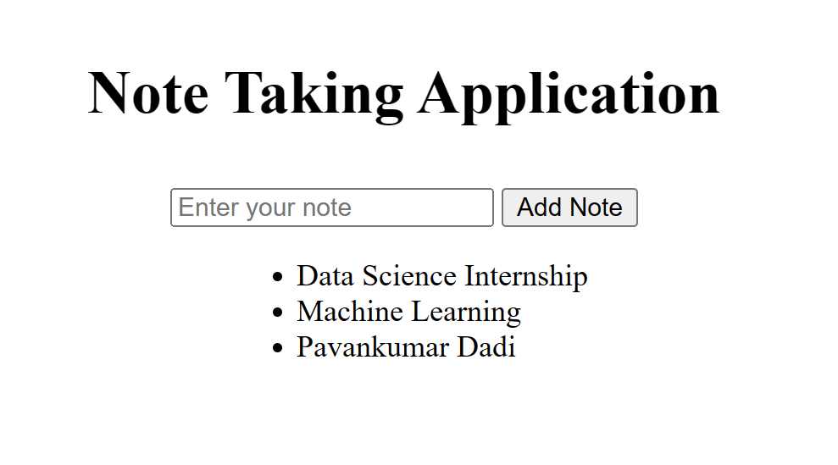
Final Output after Fixing the Bugs:
Before adding note
After adding note

Slide 9
Conclusion:-
By updating the Flask route to handle both GET and POST requests and adjusting the logic to retrieve the note from the form data for POST requests, the bug was successfully resolved. The application now functions as intended, allowing users to seamlessly add notes through the text field, and all entered notes are displayed as an unordered list below the text field on the same page. The refactoring process involved addressing issues related to the handling of HTTP requests, ensuring proper data extraction, and enhancing the overall functionality of the Note Taking Application. The collaborative effort and utilization of online resources contributed to the successful resolution of identified bugs.

Slide 10

THANK YOU

